Slide 1

WELCOME TO THE
MINISTRY LEADER MEETING
June 14, 2025
THANK YOU FOR JOINING. WE WILL BEGIN SHORTLY.

Slide 2

Executive Board (Term 2025 -2028)
1. Todd E. Hammond – Senior Pastor
2. Eddie Johnson, Jr. – President/Chairman Deacons
Rickey Houston – Business Administrator
3. Leon Adkins – Vice President/Vice-Chairman Deacons
4. Ken Grant – Treasurer
Lonnie Carr – Asst. Treasurer
5. Otis Killings – Secretary
Eric Scott – Asst. Secretary
6. Joe Butler – At Large
7. Jaffice Donaldson – At Large

Slide 3

LEADERSHIP AGENDA
Welcome and Opening Thoughts
Leadership Structure
High-Level Transition Timeline
Progress Report
Ministry Leader Reminders & Priorities
Church Calendar
Reminders & Wrap Up
Open Discussion
I. Transition Timeline Review (What have we done and what’s next)
II. Review ministry list, leaders, & contact info
III. Budget amounts by ministry & general information regarding approach
IV. Review Process to request & receive money (budgeted and/or collected)
V. Reports/Comments from 6 Functional Ministers (Worship, Evangelism, Ministry, Fellowship, Discipleship, Student Ministry)
VI. Major Calendar Events & After Action Reports (AAR)
VII. Open Floor Discussion

Slide 4


Leadership Structure
CHURCH PURPOSE
“THE GREAT COMMANDMENT”
Matthew 22:37, 39
“THE GREAT COMMISSION”
Matthew 28: 19 - 20
Acts 2: 42
Magnify the Lord
Acts 2: 45
Serving Others
Acts 2: 46
Encouraging Congregation
Acts 2: 47
Mission – Local to International
Acts 2: 43
Spiritual Maturity Biblical Education

Slide 5

H O L Y S P I R I T
Senior Teaching Pastor
Todd Hammond
Exec. Pastor/ Business Admin
Rickey Houston
Executive Board
Eddie Johnson, Jr.
Pastoral Leadership
Team
Deacon
Board
Pre-School Tanya Mason
Elementary Ruth Lubin
Pastor of Evangelism
Aaron Lewis
Minister of Worship
LaTonya Riley
Pastor of
Student Ministries Roddrick Siplin
Pastor of
Fellowship
David Hill
Pastor of Discipleship
Vacant
Pastor of Ministry
Andre’ Saunders
Supporting Ministers
Harold Frazier, Darryl Anderson, Thomas Wickes,
Nathaniel Bonner, Rickey Houston, Wallace Bowers

Slide 6
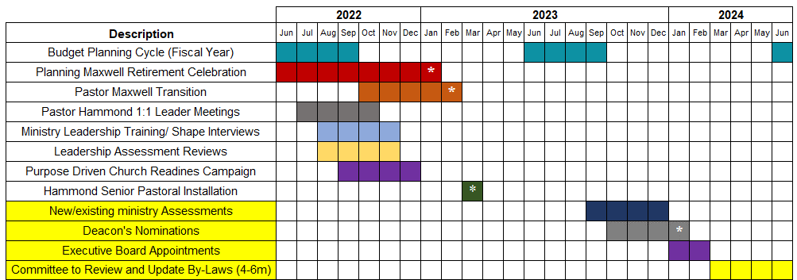

High Level Transition Timeline

Slide 7


836 Days of Progress
Evangelism Revival
Love, Transformation,Mental Wellness, Acts, Romans, OT Bible Studies
Summer Bible Studies
VBS and Mini-College Tour
Nursery & Toddler In-Service Care
Successful Homecoming 2023 (prepare for 2025)
Hired New Academy Principle (AGAIN)
Members Stewardship and congregation growth
Dedications, Baptisms, Weddings, Wellness, Fair, Women…
Security, Van, New Bible Studies, and more!
Notes:
Baby Dedications, Baptisms, Weddings

Slide 8
836 Days of Progress
Our Growth Signals
(Acts 2:41-47)
In-depth discipleship
Incredible stewardship
Intimate fellowship
Influential worship
Increased partnership
Notes:
Baby Dedications, Baptisms, Weddings

Slide 9
Ministry Leaders
What God expect from Leaders:
Leaders demonstrate spiritual maturity. (Ref Gal 5)
Leaders are constantly in a position to learn.
Leaders respect and follow authority.
Leaders are welcoming, forgiving, and faithful.
Focus on how you and the ministry are demonstrating God’s Love and creating opportunity to share the Gospel.
Leave behind old ways of thinking. Be daring.
What Leaders should expect from Pastors:
We are Spirit led, biblically based, and Kingdom minded!
CREDIBILITY - SENSITIVITY - HUMILITY

Slide 10
Church Calendar
Consolidated Web Calendar – Demonstration
How to submit ministry events for the calendar
Full year event submissions to prepare for budget
Funerals may supersede any Saturday events so always prepare alternative.

Slide 11
Ministry Priority
Develop a complete relationship with God (mind, heart, soul) - Worship
Reach Lost Souls for Christ - Evangelism
Transformed lives of believers - Discipleship
Serve our community and each other - Ministry
Connect the body in meaningful ways - Fellowship
Every Ministry will be reviewed and assessed
Each will be rated: Resume, Refocus, or Retire
Reviews to be completed with review committee & current leader
New ministry needs should be recommended during this time

Slide 12
Ministry Budgets
Investment priorities will be made in ministries that are growing and generating growth inside and outside the church walls! This means activities with sharing the Gospel take priority.
Remember to request funds at least 2 weeks before needed (not before the date of an event)
All funds require receipts be turned into church comptroller
If in doubt, ask before you spend your own money. Church will not reimburse for unauthorized items. (i.e. Zoom fees, personal items, excessive taxes)

Slide 13
Reminders & Wrap Up
Continue single Worship service (until attendance necessitates change)
Church Security focus (People and Property)
-Retraining from contractor
-Security camera monitoring to resume
- Other measures discussed by Security
Next Church wide Ministry leader meeting will be October
- Individuals and smaller groups will meet throughout
Major Calendar Events – Should be done now
After Action Reports
Church.app Mobile app for ministry leaders.
    www.fbcopv.org/app Available for IOS & Android

Slide 14
Open Floor Discussion

